Slide 1

Bellabeat Case Study
By Jordyn Ohashi

Slide 2
The Problem
Company
Bellabeat, a high-tech company that manufactures health-focused smart products including: Bellabeat app Leaf Time Spring Bellabeat membership
Context
Since it was founded in 2013, Bellabeat has grown rapidly and quickly positioned itself as a tech-driven wellness company for women The company focuses on digital marketing extensively and wants to find more opportunities for growth
Problem Statement
Identify trends in smart device usage and how the trends can be used to guide marketing strategies

Slide 3
Data
Datasets
Dataset of Consumer-Based Activity Trackers
Collected activity from participants using a Fitbit or Garmin
National Health and Nutrition Examination Survey
Includes answers to questions on sleep habits and disorders
Fitbit Fitness Tracker Data
Collected Fitbit data from Amazon Mechanical Turk
Notebook
Full analysis available on GitHub
Click here

Slide 4
Cleaning
Searching for high level trends, so focused on daily activity data
Not enough data collected for sleep or weight data therefore excluded
Only include data where users used the device for an adequate amount of time, at least 150 steps
Removed duplicate data
Reformatted data to same data types
Merged Fitbit dataset and Dataset of Consumer-Based Activity Trackers

Slide 5
What was measured & analyzed
Variables
Date
Steps
Calories
Minutes of activity
Watch provider
Number of uses per participant
Analyzed
Found the averages, minimums, maximums, etc. for the variables
Analyzed the distributions of the variables
Compared variables looking for correlations
Analyzed the spread of the tracking data over time

Slide 6
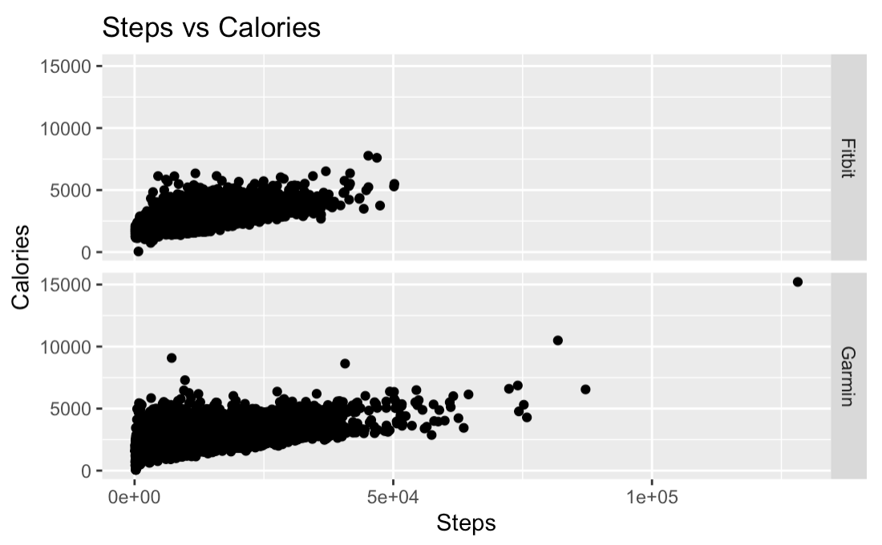
Results
Positive correlation
Garmin
r(41768) = 0.544, p < 2.2e-16
Fitbit
r(25355) = 0.540, p < 2.2e-16

Slide 7
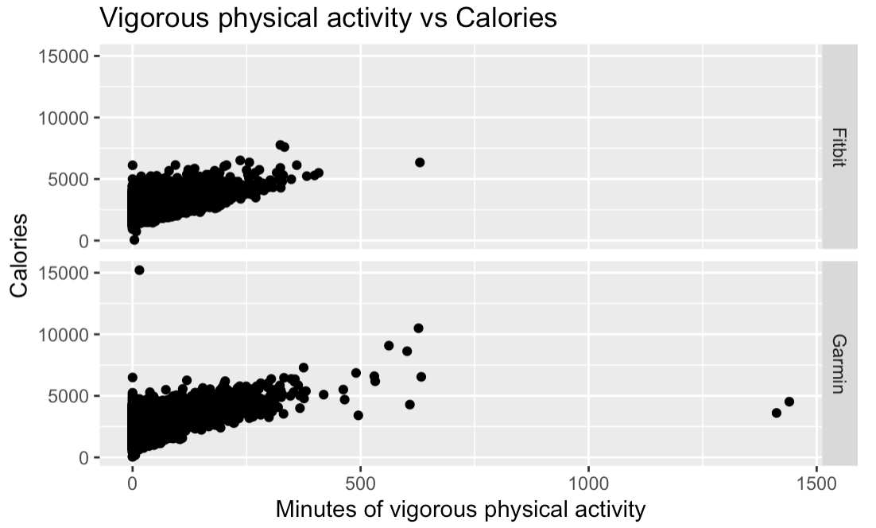
Results
Positive correlation
Garmin
r(41768) = 0.613, p < 2.2e-16
Fitbit
r(25355) = 0.517, p < 2.2e-16

Slide 8
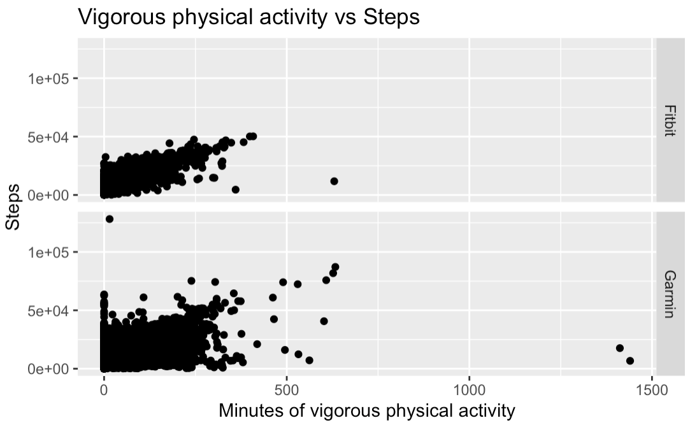
Results
Positive correlation
Garmin
r(41768) = 0.568, p < 2.2e-16
Fitbit
r(25355) = 0.779, p < 2.2e-16

Slide 9
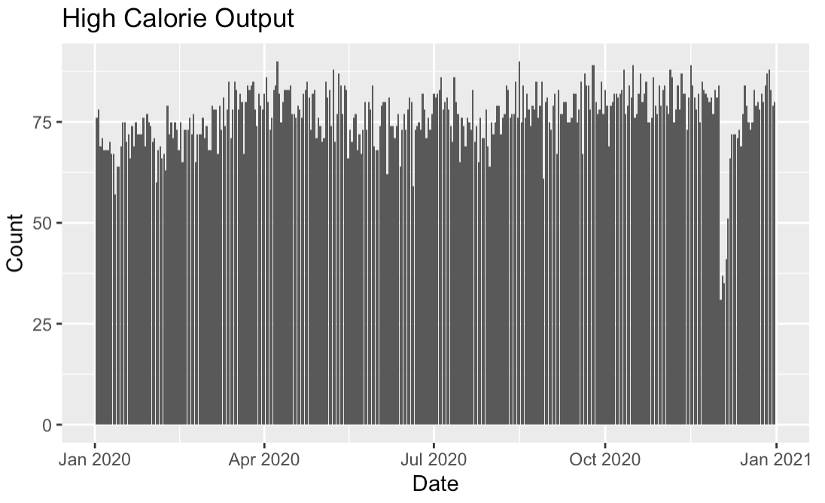
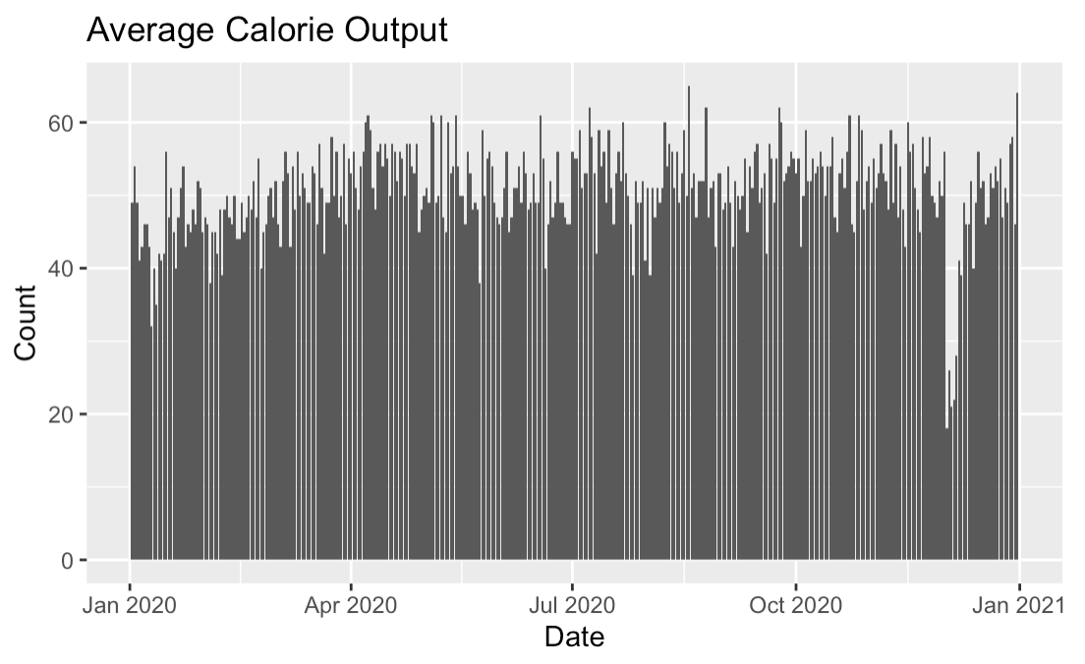
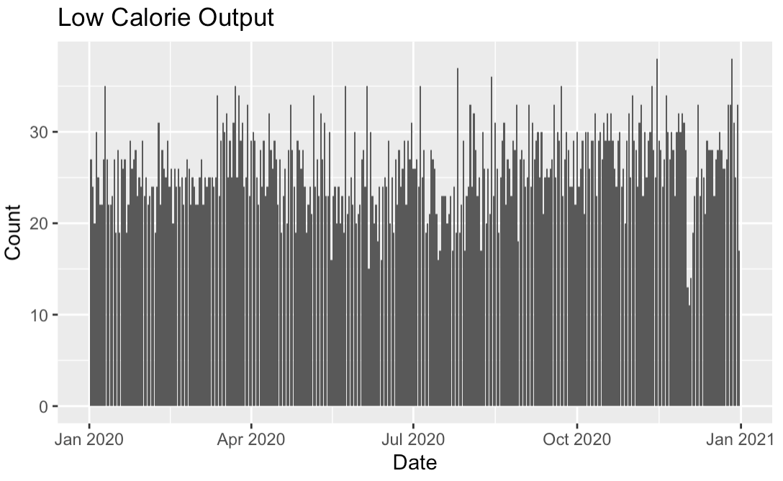
Results
People with a lower calorie output have a lower consistency
People with an average calorie output are more consistent exercising
People with a high calorie output have high consistency and frequency

Slide 10
Audience
Bellabeat focuses on helping women take charge of their health and fitness
From a survey fitness bands are more popular than smartwatches among women
The COVID-19 pandemic boosted the market as consumers were forced to spend more time at home, find new ways of exercising due to limited gym access, and sometimes monitor their medical health
Moreover, women are the main target for Bellabeat, and fitness bands are more popular among them so there should be an increase of focus on their leaf product

Slide 11
Strategy
Based on data from tracking devices, digital marketing should be focused on how women can increase their health by consistently working out using the Leaf product
The more people tracked their fitness the more consistent and frequently they exercised
Higher level activity leads to more calories burned so marketing should portray how the Leaf encourages high level activity with daily goals

